Slide 1

Lecture 3. Memory Hierarchies – Models and Bounds
Speaker
…

Slide 2
Lecture 3. Memory Hierarchies – Models and Bounds
Agenda
Memory Hierarchies:
external–memory model
cache-oblivious model
cache-oblivious B-trees

Slide 3
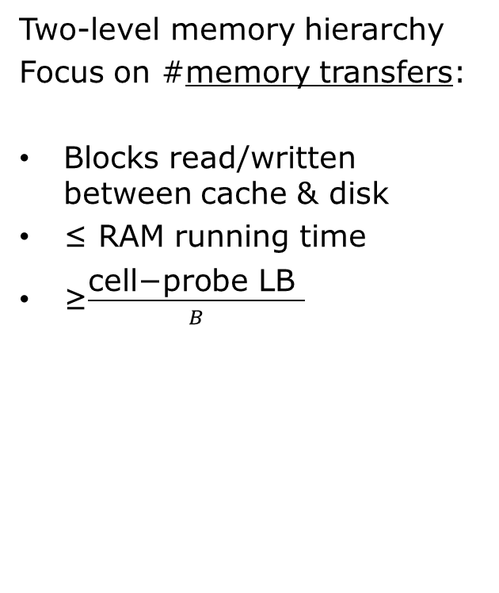


Lecture 3. Memory Hierarchies – Models and Bounds
External memory/I/0/
Disk Access Model:[1]
Two-level memory hierarchy
Focus on #memory transfers:
Blocks read/written between cache & disk
≤ RAM running time
≥$\frac{\text{cell}\text{−}\text{probe} \text{LB} }{B}$
.
CPU
$$\frac{M}{B}$$
blocks
blocked
$$∞$$
slow
FAST
block=B words
CACHE/MEMORY
DISK

Slide 4
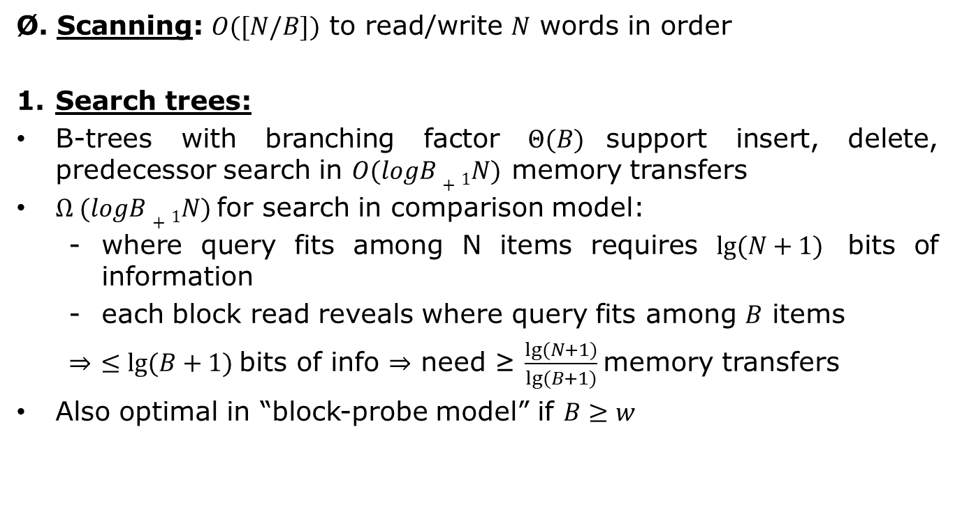
Lecture 3. Memory Hierarchies – Models and Bounds
Basic results in external memory
Ø. Scanning: $O([N/B])$ to read/write $N$ words in order
Search trees:
B-trees with branching factor $Θ(B)$support insert, delete, predecessor search in $O(logB+1N)$ memory transfers
$Ω (logB+1N)$for search in comparison model:
where query fits among N items requires $lg⁡(N+1)$ bits of information
each block read reveals where query fits among $B$ items
$⇒$ $≤lg⁡(B+1)$bits of info ⇒ need ≥ $\frac{lg⁡(N+1)}{lg⁡(B+1)}$memory transfers
Also optimal in “block-probe model” if $B≥w$

Slide 5
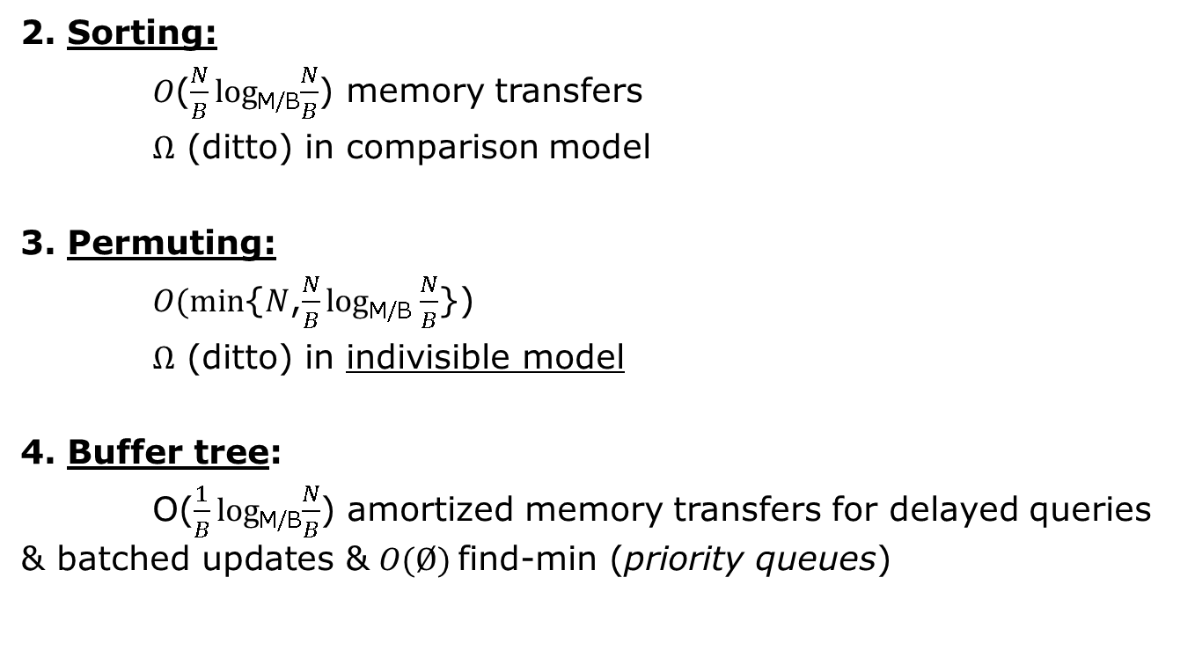
Lecture 3. Memory Hierarchies – Models and Bounds
Basic results in external memory
2. Sorting:
$O$($\frac{N}{B}log$_{M/B}$\frac{N}{B}$) memory transfers
$Ω$ (ditto) in comparison model
3. Permuting:
$O(min${$N$,$\frac{N}{B}log$_{M/B} $\frac{N}{B}$})
$Ω$ (ditto) in indivisible model
4. Buffer tree:
O($\frac{1}{B}log$_{M/B}$\frac{N}{B}$) amortized memory transfers for delayed queries & batched updates & $O(Ø)$find-min (priority queues)

Slide 6

Lecture 3. Memory Hierarchies – Models and Bounds
Cache-oblivious model [11]
like external-memory model
but algorithm does not know $B$ or $M$ $⇒$ must work for all $B$ & $M$
automatic block transfers triggered by word access with offline optimal block replacement
FIFO, LRU or any conservative replacement is 2-competitive given cache of 2x size (resource augmentation)
dropping $M$ $↘M/2$ does not affect typical bounds

Slide 7


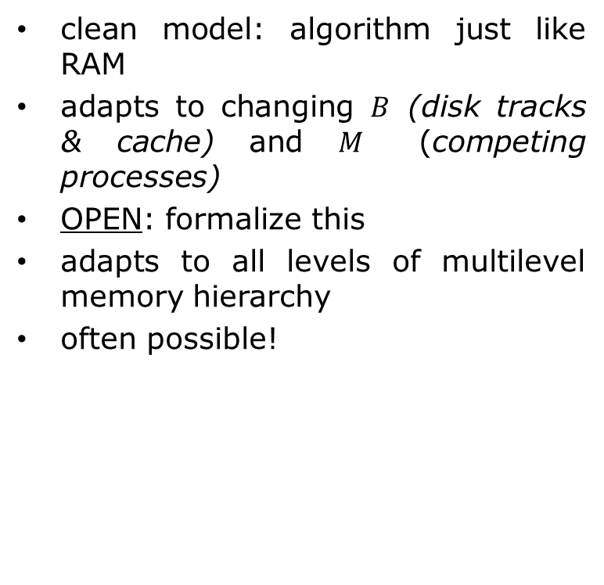






Lecture 3. Memory Hierarchies – Models and Bounds
Cool
clean model: algorithm just like RAM
adapts to changing $B$ (disk tracks & cache) and $M$ (competing processes)
OPEN: formalize this
adapts to all levels of multilevel memory hierarchy
often possible!
$$B_{4}$$
$$B_{2}$$
$$B_{3}$$
$$B_{1}$$
CPU
L1
L2
L3
L4
$$M_{1}$$
$$M_{2}$$
$$M_{2}$$
$$M_{3}$$

Slide 8
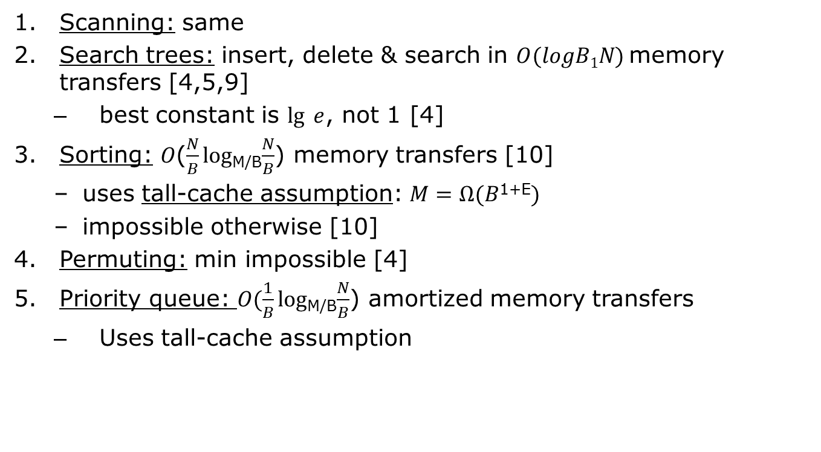
Lecture 3. Memory Hierarchies – Models and Bounds
Basic cache-oblivious results:
Scanning: same
Search trees: insert, delete & search in $O(logB1N)$memory transfers [4,5,9]
best constant is $lg⁡ e$, not 1 [4]
Sorting: $O$($\frac{N}{B}log$_{M/B}$\frac{N}{B}$) memory transfers [10]
uses tall-cache assumption: $M=Ω(B$^{1+E}$)$
impossible otherwise [10]
Permuting: min impossible [4]
Priority queue: $O(\frac{1}{B}log$_{M/B}$\frac{N}{B}$) amortized memory transfers
Uses tall-cache assumption

Slide 9


















Lecture 3. Memory Hierarchies – Models and Bounds
Cache-oblivious static search trees (binary search)[11]
store N elements in N-node complete BST
carve tree at middle level of edges, one top piece ≈$\sqrt{N}$ bottom pieces, each size ≈$\sqrt{N}$
$$\frac{1}{2}lgN$$
$$\sqrt{N}$$
$$lgN$$
$$\sqrt{N}$$
$$\sqrt{N}$$
$$\sqrt{N}$$
$$\sqrt{N}$$
$$\sqrt{N}$$
$$⋯$$
$$\sqrt{N}$$
$$\frac{1}{2}lgN$$
$$\sqrt{N}$$
$$\sqrt{N}$$
$$⋯$$
$$\sqrt{N}$$
$$≈\sqrt{N}$$
$$≈\sqrt{N}$$

Slide 10
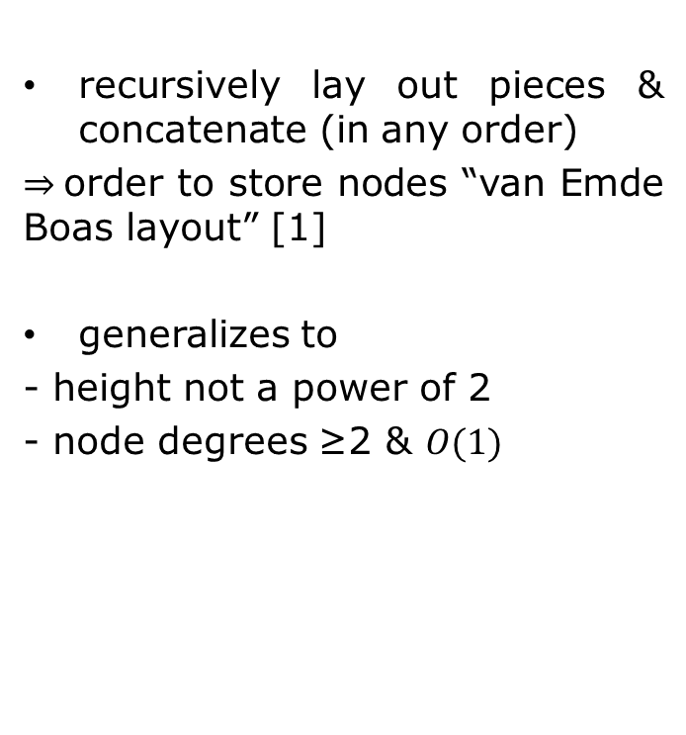
Lecture 3. Memory Hierarchies – Models and Bounds
Cache-oblivious static search trees (binary search)[11]
recursively lay out pieces & concatenate (in any order)
$⇒$order to store nodes “van Emde Boas layout” [1]
generalizes to
- height not a power of 2
- node degrees ≥2 & $O(1)$
1
2
3
13
15
14
10
11
12
8
9
4
7
5
6

Slide 11

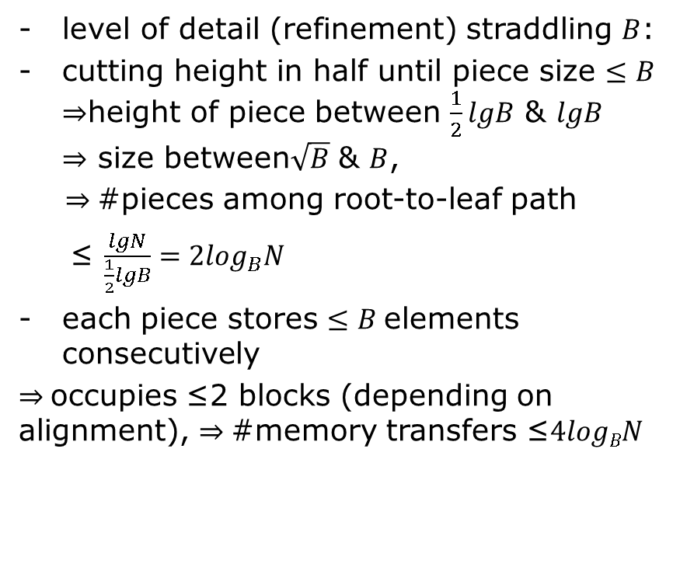



Lecture 3. Memory Hierarchies – Models and Bounds
Analysis
level of detail (refinement) straddling $B$:
cutting height in half until piece size $≤B$ $⇒$height of piece between $\frac{1}{2}lgB$ & $lgB$ $⇒$ size between$\sqrt{B}$ & $B$,
$⇒$#pieces among root-to-leaf path
≤ $\frac{lgN}{\frac{1}{2}lgB}=2\log_{B}N$
each piece stores $≤B$elements consecutively
$⇒$occupies ≤2 blocks (depending on alignment), $⇒$#memory transfers ≤$4logBN$
≤B
>B
$$⋯$$
≤B
≤B
$$⋯$$
>B
≤B
≤B
>B
$$⋯$$
$$⋯$$
≤B
≤B
≤B
≤B

Slide 12

Lecture 3. Memory Hierarchies – Models and Bounds
Improvements
randomize starting location (w.r.t. block)
$⇒$expected cost $≤(2+\frac{3}{\sqrt{B}}$)$logBN$
2. split height into $\frac{1}{2}$-$ε :\frac{1}{2}\text{+}ε$ ratio $⇒$expected cost $≤(lg⁡e+o(1)) logBN$

Slide 13
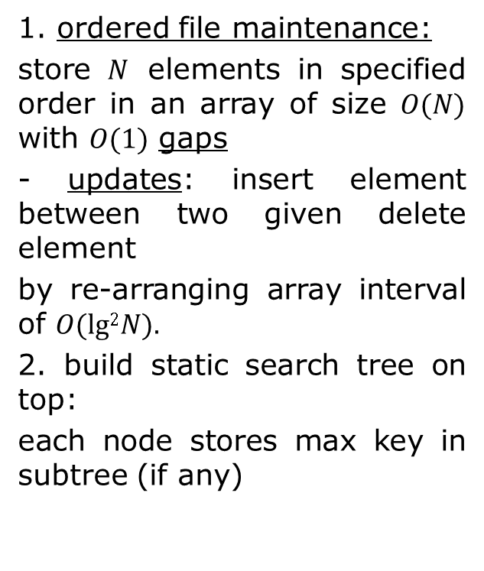
Lecture 3. Memory Hierarchies – Models and Bounds
Cache-oblivious B-tree [4]
42
9
42
42
21
42
16
16
/
9
7
3
9
/
3
1. ordered file maintenance:
store $N$ elements in specified order in an array of size $O(N)$ with $O(1)$ gaps
- updates: insert element between two given delete element
by re-arranging array interval of $O(lg2N).$
2. build static search tree on top:
each node stores max key in subtree (if any)
vEB
layout
1
3 / 7 9 / 16 21 42

Slide 14
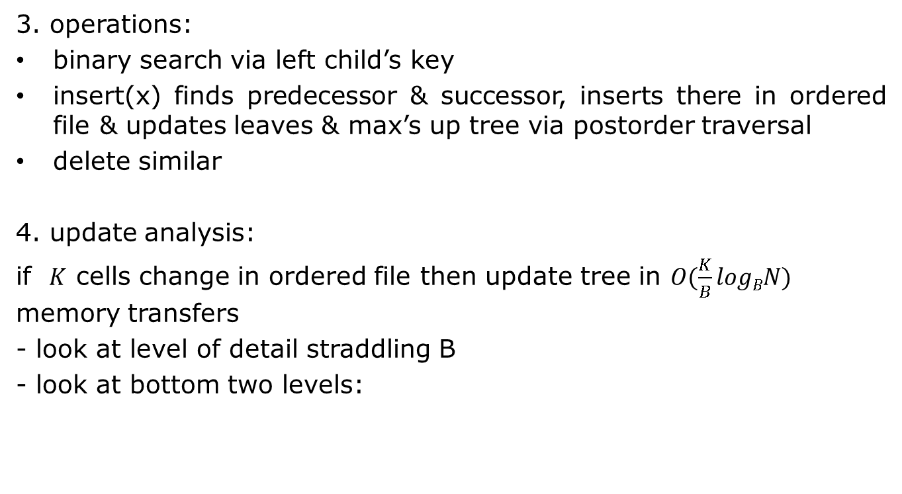
Lecture 3. Memory Hierarchies – Models and Bounds
Cache-oblivious B-tree
3. operations:
binary search via left child’s key
insert(x) finds predecessor & successor, inserts there in ordered file & updates leaves & max’s up tree via postorder traversal
delete similar
4. update analysis:
if $K$ cells change in ordered file then update tree in $O(\frac{K}{B}logBN)$ memory transfers
- look at level of detail straddling B
- look at bottom two levels:

Slide 15

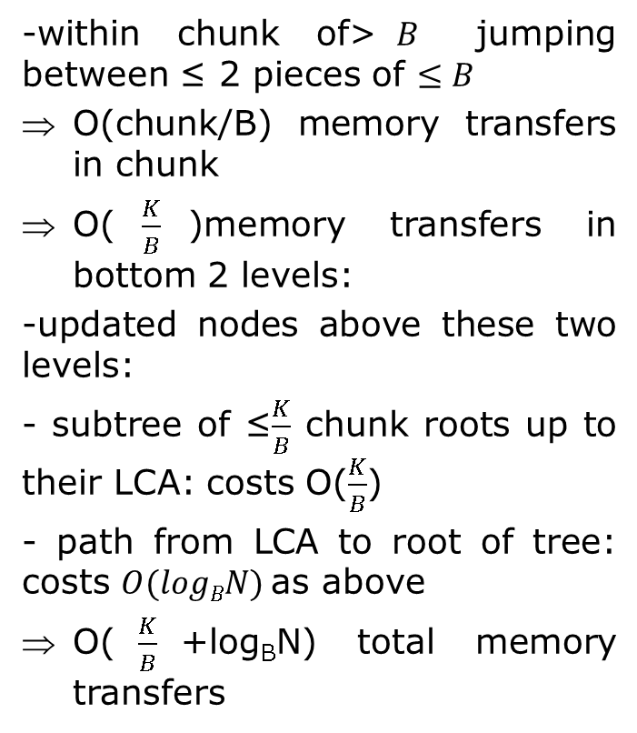





Lecture 3. Memory Hierarchies – Models and Bounds
Cache-oblivious B-tree
-within chunk of>$B$ jumping between ≤ 2 pieces of $≤B$
O(chunk/B) memory transfers in chunk
O($\frac{K}{B}$)memory transfers in bottom 2 levels:
-updated nodes above these two levels:
- subtree of ≤$\frac{K}{B}$ chunk roots up to their LCA: costs O($\frac{K}{B}$)
- path from LCA to root of tree: costs $O(logBN)$as above
O($\frac{K}{B}$+log_{B}N) total memory transfers
$$⋯$$
>B
≤B
$$⋯$$
≤B
>B
$$⋯$$
$$⋯$$
$$⋯$$
≤B
≤B
≤B
≤B
change interval
So far:
search in $O(logBN)$
update in $O(logBN$+$\frac{\lg^{2}}{B}N)$ amortize

Slide 16


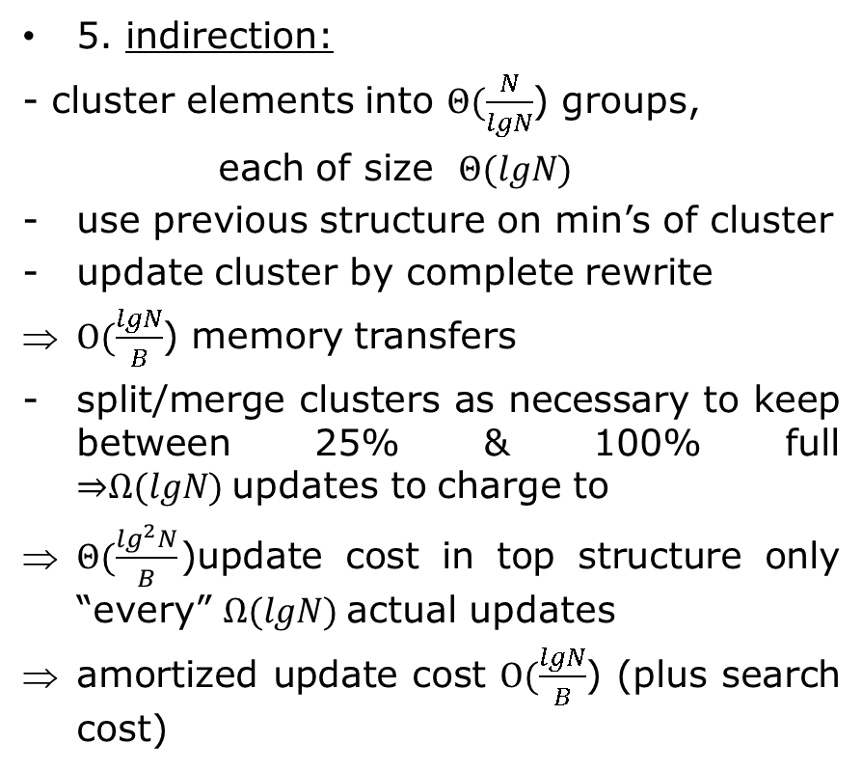


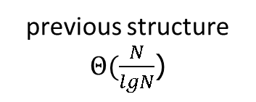
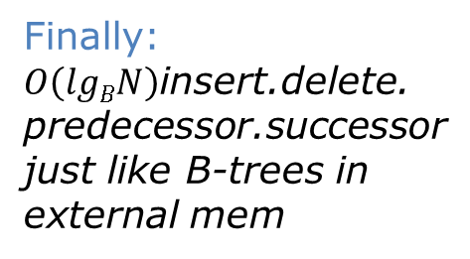
Lecture 3. Memory Hierarchies – Models and Bounds
Cache-oblivious B-tree
5. indirection:
- cluster elements into $Θ(\frac{N}{lgN}$) groups,
each of size $Θ(lgN)$
use previous structure on min’s of cluster
update cluster by complete rewrite
$O(\frac{lgN}{B}$) memory transfers
split/merge clusters as necessary to keep between 25% & 100% full ⇒$Ω(lgN)$updates to charge to
$Θ(\frac{\lg^{2}N}{B}$)update cost in top structure only “every” $Ω(lgN)$actual updates
amortized update cost $O(\frac{lgN}{B}$) (plus search cost)
previous structure $Θ(\frac{N}{lgN}$)
min
min
$$⋯$$
min
$$Θ(lgN)$$
$$Θ(lgN)$$
$$Θ(lgN)$$
Finally:
$O\left(lgBN\right)$insert.delete.
predecessor.successor
just like B-trees in
external mem

Slide 17
Lecture 3. Memory Hierarchies – Models and Bounds
Bibliography
1. A. Aggarwal and J. S. Vitter. The input-output complexity of sorting and related problem
2. L. Arge. The buffer tree A technique for designing batched external data structures.
3. L. Arge, M. A. Bender, E. D. Demaine, B. Holland-Minkley, and J. I. Munro. Cache-oblivious priority queue and graph algorithm applications
4. M. A. Bender, E. D. Demaine, and M. Farach-Colton. Cache-oblivious B-trees
5. M. A. Bender, Z. Duan, J. Iacono, and J. Wu. A locality-preserving cache-oblivious dynamic dictionary
6. G. S. Brodal and R. Fagerberg. Funnel heap a cache oblivious priority queue
7. G. S. Brodal and R. Fagerberg. Cache oblivious distribution sweeping
8. G. S. Brodal and R. Fagerberg. On the limits of cache-obliviousness
9. G. S. Brodal, R. Fagerberg, and R. Jacob. Cache oblivious search trees via binary trees of small height
10. M. Frigo, C. E. Leiserson, H. Prokop, and S. Ramachandran. Cache-oblivious algorithms
11. H. Prokop. Cache-oblivious algorithms. Master's thesis, Massachusetts Institute of Technology

